Slide 1


AI-Powered Data Processing
With Modin and Snowflake Cortex

Slide 2


Contents
Overview
Architecture
Demo
Business Impact

Slide 3
Overview
Modin for Scalable Data Processing: Enables pandas-like syntax with distributed backend support to handle large datasets efficiently
Snowflake Cortex for AI/ML: Provides pre-trained LLMs, embeddings, and advanced AI models for tasks like entity extraction, summarization, or predictive analytics directly within Snowflake.
Seamless Pipeline: Data flows from ingestion -> transformation (modin) -> AI inference (Cortex) -> storage/visualization in Snowflake within minimal overhead.

Slide 4
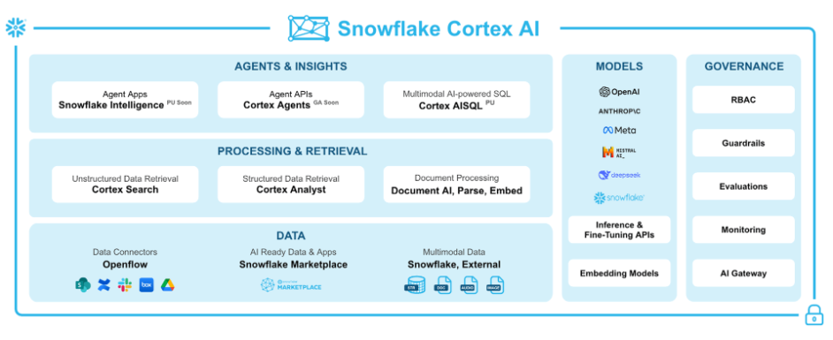
Architecture

Slide 5
Business Impact
Accelerates ETL and data enrichment workflows
Brings AI-driven decision-making closer to real time
Reduces operational complexity by using cloud-native AI services

